Slide 1

Module I – Responsive Web Design

Slide 2
Introduction to CSS
CSS Media Types
CSS media types are used to define different styles for different types of devices or media.
Media types allow you to apply specific styles based on the characteristics of the output device, such as screen, print, or speech.
This helps create a responsive design that adjusts to different environments.

Slide 3
Introduction to CSS
Here are some commonly used CSS media types:
all
print
handheld
screen
aural
braille

Slide 4
Introduction to CSS
all:
This is the default media type. Styles defined within @media all { ... } will apply to all devices.
print:
Styles within @media print { ... } will apply when a document is printed or viewed in print preview.
handheld:
The 'handheld' media type is tailored for small devices like smartphones and handheld gaming consoles. Styles within @media handheld { ... } are designed to enhance usability on smaller screens, potentially adjusting font sizes, layouts, and interactive elements for a more comfortable experience.

Slide 5
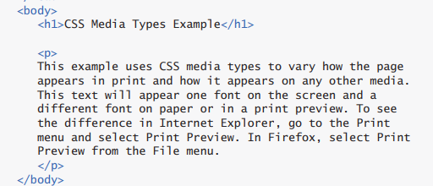
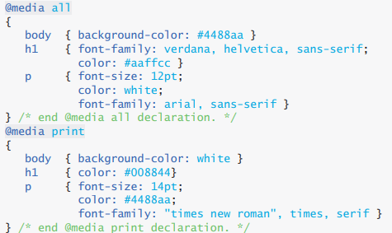
HTML
CSS

Slide 6
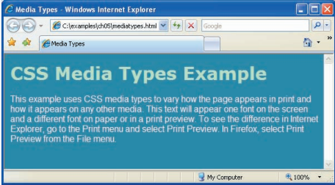
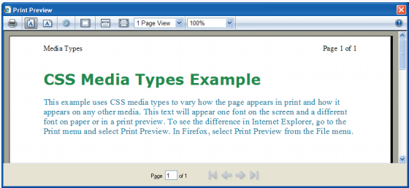
Output on screen
Output on print preview
You could see how the same content
is rendered in different formats
based
upon the
CSS
MEDIA TYPE
DECLARATIONs

Slide 7
Introduction to CSS
screen: Styles within @media screen { ... } will apply to devices with a screen, such as computers, tablets, and smartphones.
aural: The 'aural' media type is designed for devices that present information through sound, such as screen readers. Styles applied within @media aural { ... } are optimized for an auditory experience, ensuring clear and understandable rendering of content.
braille: The 'braille' media type targets devices equipped with braille displays. Styles within @media braille { ... } are crafted to provide an accessible and tactile reading experience, often involving adjustments in spacing and formatting.

Slide 8
Introduction to CSS
CSS Media Queries
Media queries provide a way to conditionally apply styles based on specific features or characteristics of the user's device or viewport.
Media queries are commonly used to implement responsive web design, ensuring a seamless experience across a variety of devices.
Btw, what is a viewport?
Viewport represents the portion of the webpage that a user can see at any given time. The size and characteristics of the viewport play a crucial role in responsive web design.

Slide 9
Introduction to CSS
General Syntax:
Media queries are written using the @media rule, followed by a condition or query. If the condition is true, the styles within the media query are applied.
@media screen and (max-width: 600px) {
/* Styles for screens with a maximum width of 600px */
}
Conditions: Media queries include conditions based on various features such as width, height, device orientation, and more. Common conditions include min-width, max-width, orientation, min-device-width, and max-device-width.
@media (orientation: landscape) {
/* Styles for devices in landscape orientation */
}

Slide 10
Introduction to CSS
Logical Operators: Logical operators like and, or, and not can be used to combine multiple conditions within a media query.
@media screen and (min-width: 768px) and (max-width: 1024px) {
/* Styles for screens with a width between 768px and 1024px */
}
Hold Ctrl and click on the links below. Once you are on the website, minimize and maximize the browser slowly with the help of your mouse to see Media-Queries in Action
Example 1: W3Schools Tryit Editor
Example 2: W3Schools Tryit Editor

Slide 11
Introduction to CSS
Dropdown Menus
In web development, a dropdown refers to a graphical user interface element that allows users to select one option from a list.
Dropdowns are commonly used in navigation menus or forms.
Hold Ctrl and click on the links below. Once you are on the website, follow the instructions there.
Dropdown Example

Slide 12
What is Responsive Web Design?
Responsive Web Design is about using HTML and CSS to automatically resize, hide, shrink, or enlarge, a website, to make it look good on all devices (desktops, tablets, and phones):
RWD
Viewport
Media Queries

Slide 13
What is The Viewport?
The viewport is the user's visible area of a web page.
The viewport varies with the device, and will be smaller on a mobile phone than on a computer screen.
Before tablets and mobile phones, web pages were designed only for computer screens, and it was common for web pages to have a static design and a fixed size.
Then, when we started surfing the internet using tablets and mobile phones, fixed size web pages were too large to fit the viewport.
To fix this, browsers on those devices scaled down the entire web page to fit the screen.
This was not perfect!! But a quick fix.

Slide 14
Setting The Viewport
HTML5 introduced a method to let web designers take control over the viewport, through the <meta> tag.
You should include the following <meta> viewport element in all your web pages:
<meta name="viewport" content="width=device-width, initial- scale=1.0">
This gives the browser instructions on how to control the page's dimensions and scaling.
The width=device-width part sets the width of the page to follow the screen-width of the device (which will vary depending on the device).
The initial-scale=1.0 part sets the initial zoom level when the page is first loaded by the browser.

Slide 15
Size Content to The Viewport
Users are used to scroll websites vertically on both desktop and mobile devices - but not horizontally!
Some additional rules to follow:
1. Do NOT use large fixed width elements - For example, if an image is displayed at a width wider than the viewport it can cause the viewport to scroll horizontally. Remember to adjust this content to fit within the width of the viewport.
2. Do NOT let the content rely on a particular viewport width to render well - Since screen dimensions and width in CSS pixels vary widely between devices, content should not rely on a particular viewport width to render well.
3. Use CSS media queries to apply different styling for small and large screens - Setting large absolute CSS widths for page elements will cause the element to be too wide for the viewport on a smaller device. Instead, consider using relative width values, such as width: 100%. Also, be careful of using large absolute positioning values. It may cause the element to fall outside the viewport on small devices.

Slide 16
What is a Media Query?
Media query is a CSS technique introduced in CSS3.
The @media rule is used in media queries to apply different styles for different media types/devices.
Media queries can be used to check many things, such as:
width and height of the viewport
width and height of the device
orientation (is the tablet/phone in landscape or portrait mode?)
resolution
Using media queries are a popular technique for delivering a tailored style sheet (responsive web design) to desktops, laptops, tablets, and mobile phones.

Slide 17
Media query syntax-CSS
CSS Syntax
@media not|only mediatype and (mediafeature and|or|not mediafeature) {
CSS-Code;
}
not: The not keyword inverts the meaning of an entire media query.
only:The only keyword prevents older browsers that do not support media queries with media features from applying the specified styles. It has no effect on modern browsers.
and: The and keyword combines a media feature with a media type or other media features.
They are all optional. However, if you use not or only, you must also specify a media type.

Slide 18
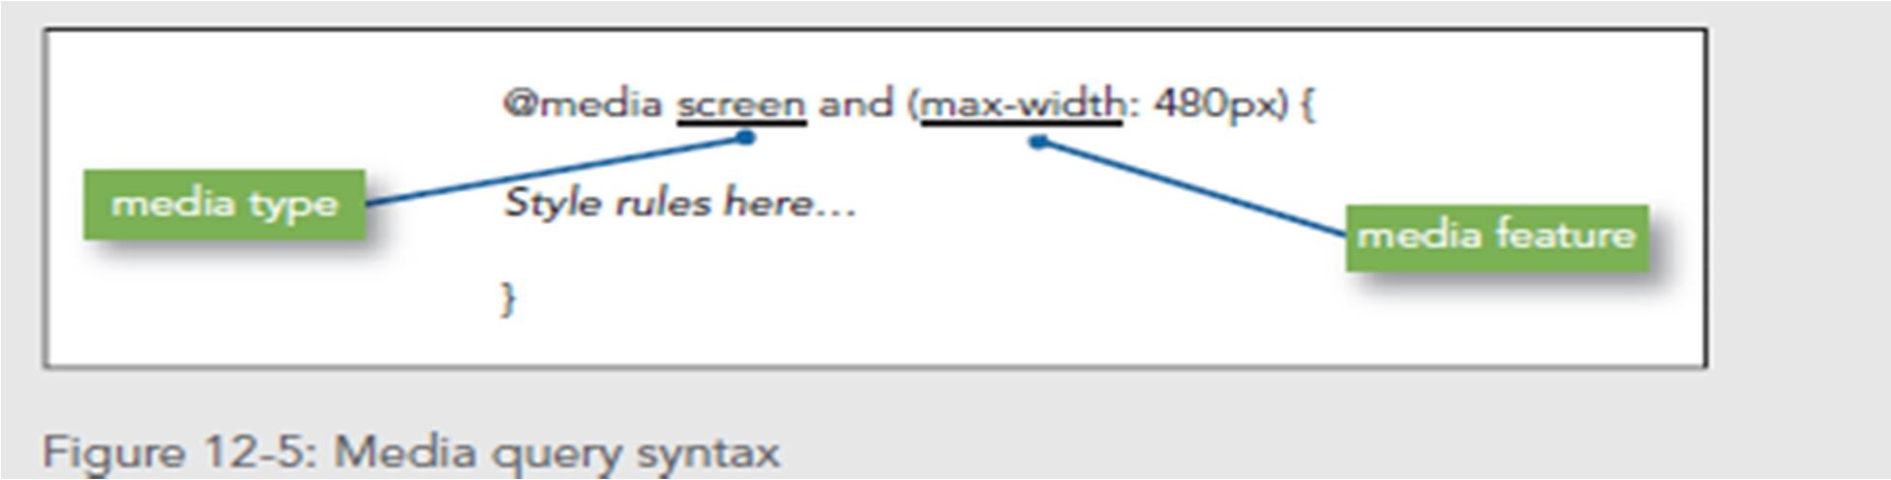
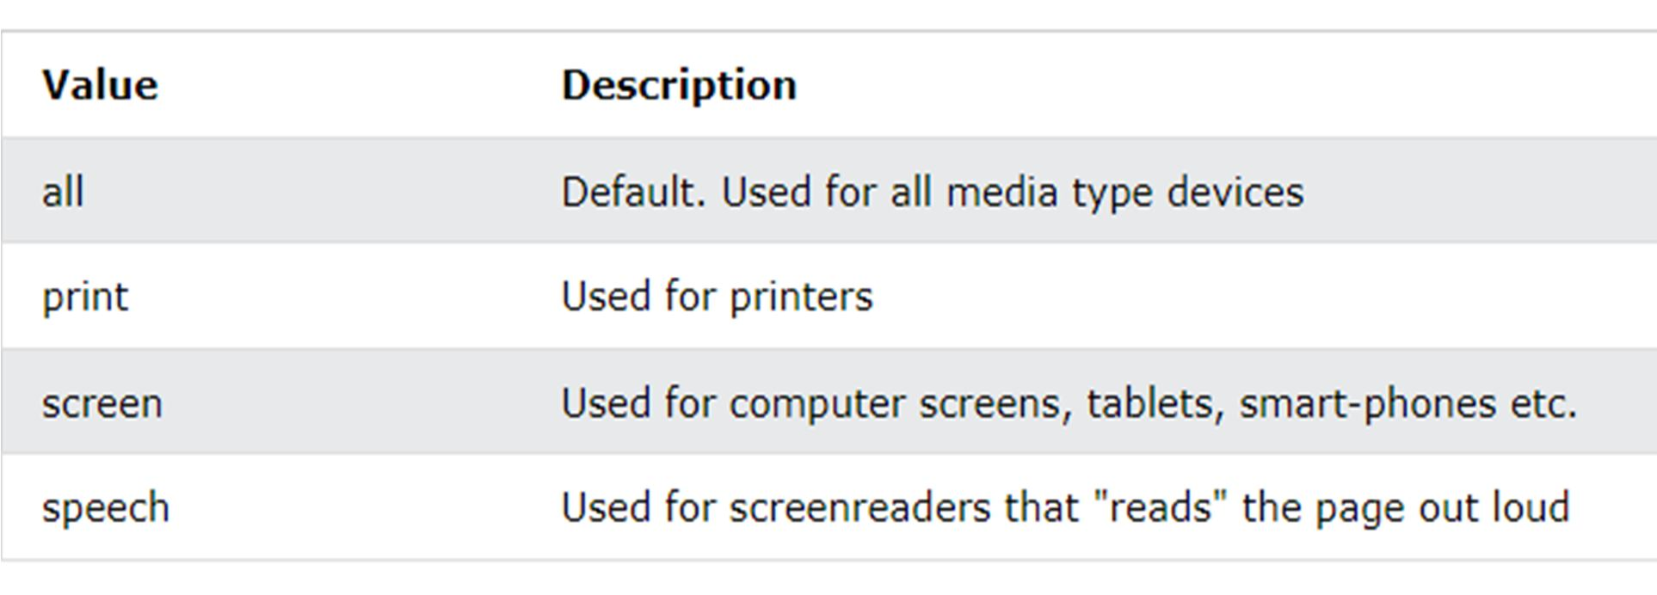
Media type

Slide 19
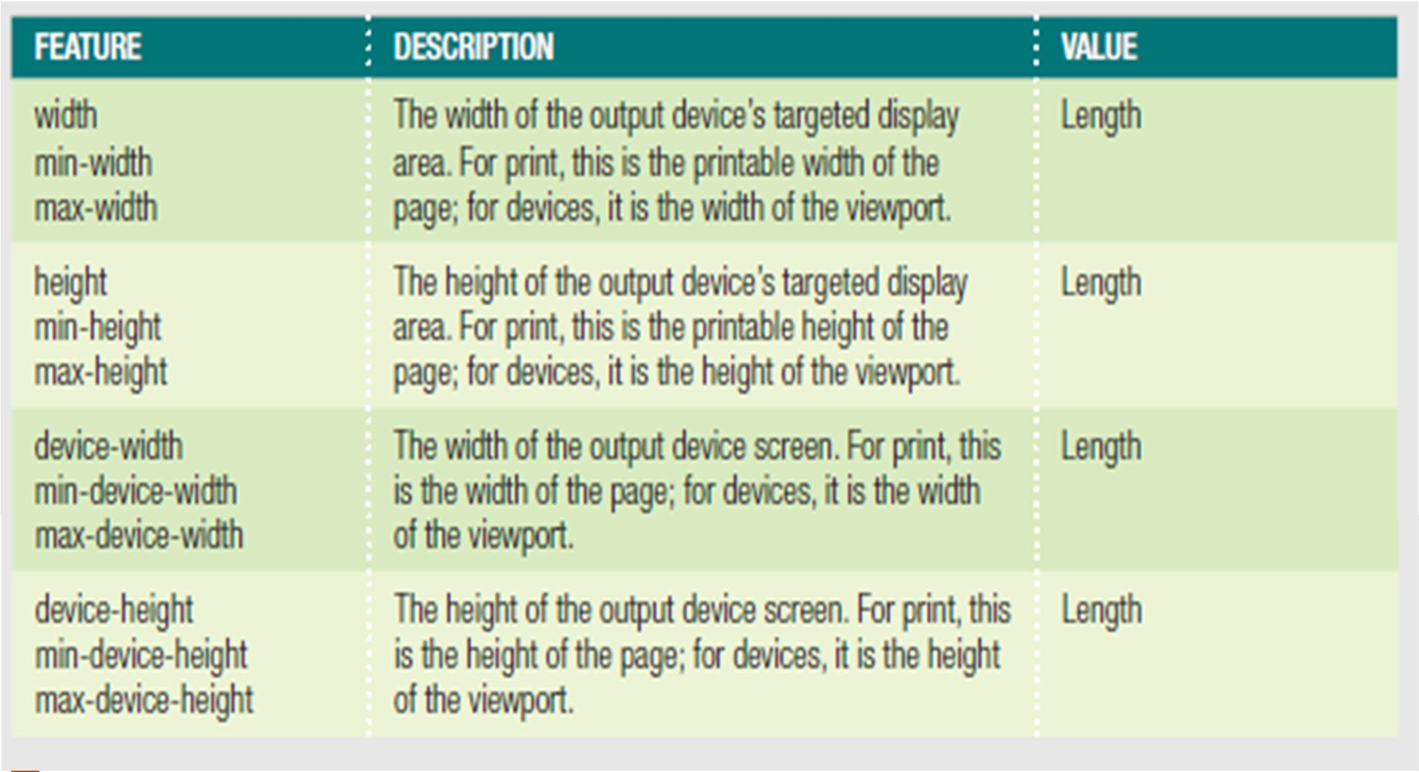
Media Features
min- and max- prefixes to express constraints.

Slide 20
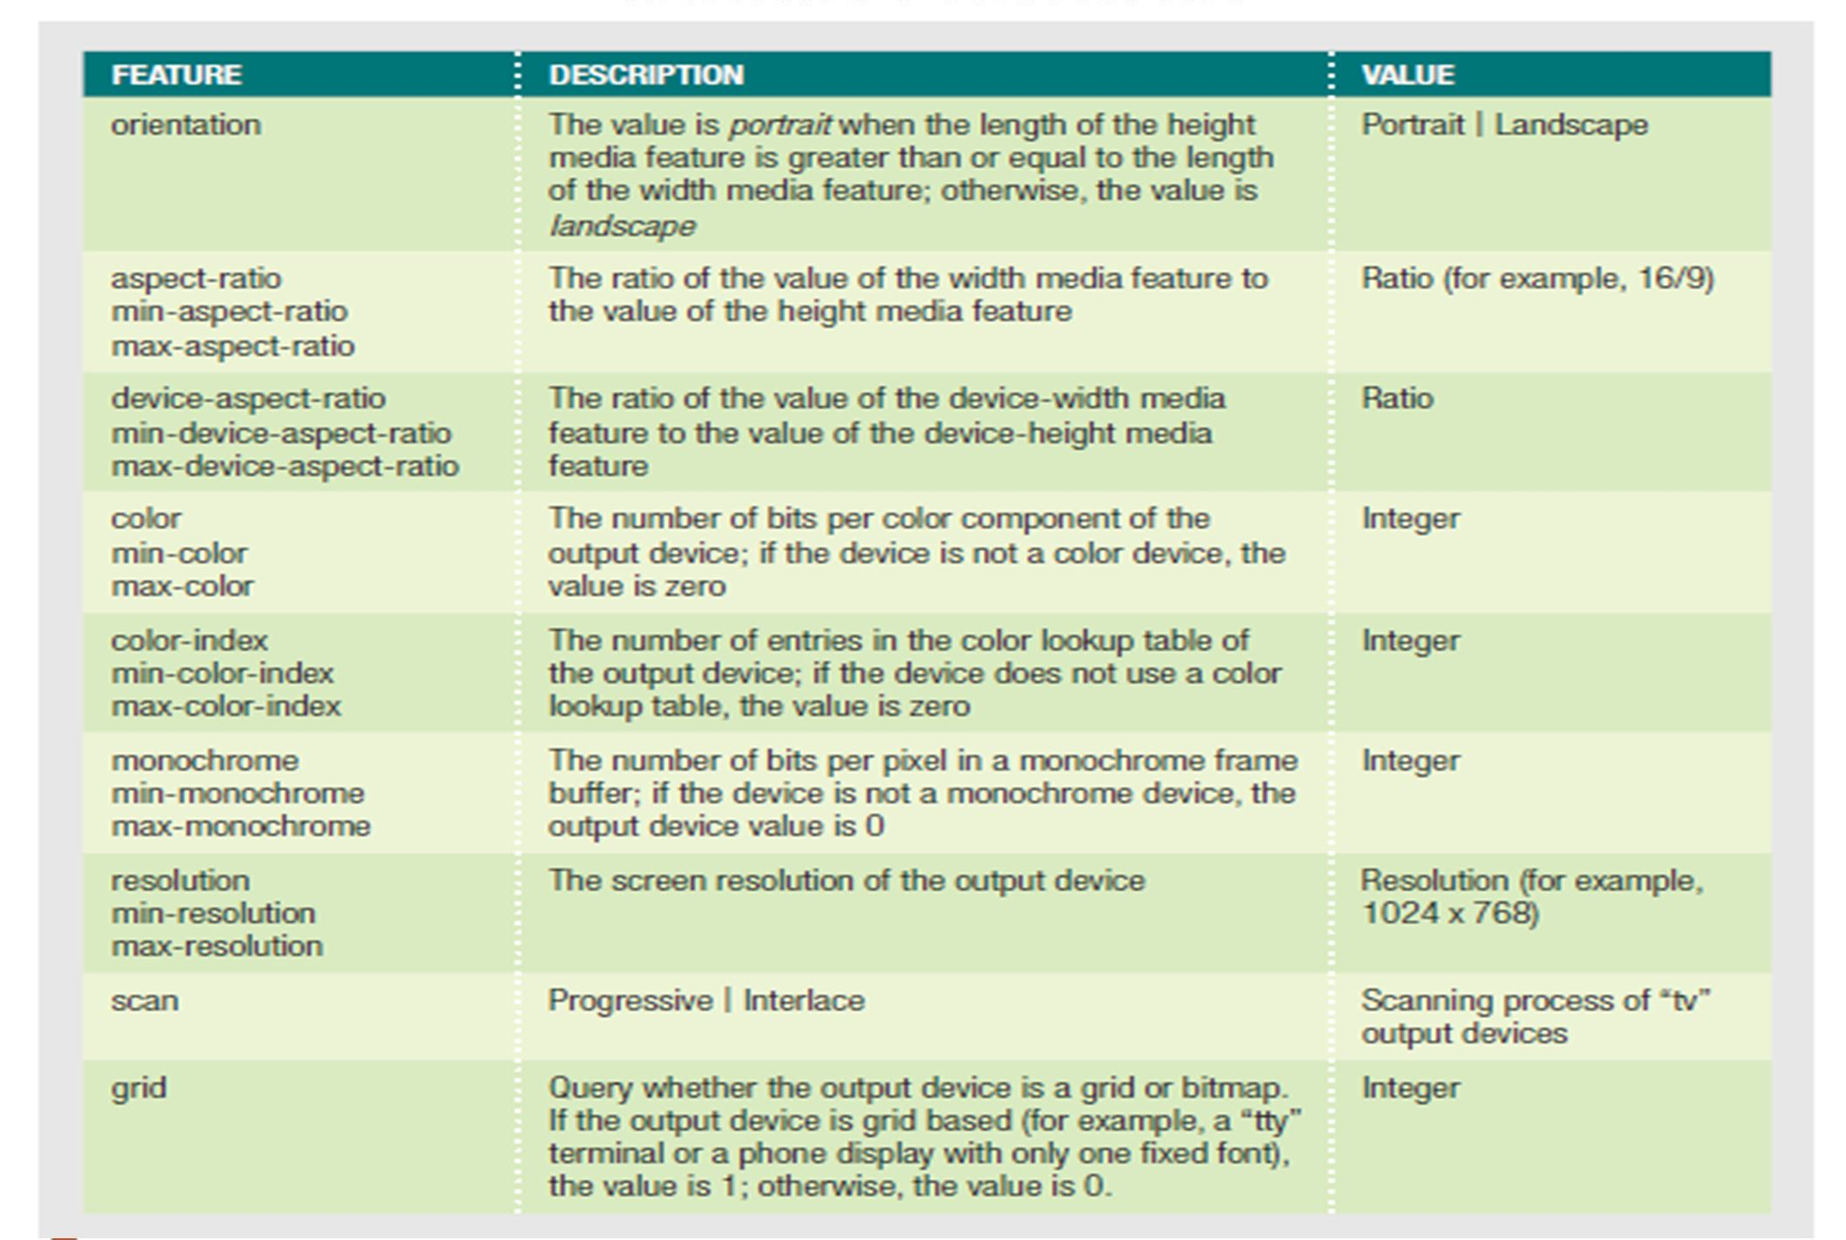
Media Features

Slide 21
Media query examples
If the browser window is 600px or smaller, the background color will be lightblue:
@media only screen and (max-width: 600px) { body {
background-color: lightblue;
}
}
Hide an element when the browser's width is 600px wide or less: @media screen and (max-width: 600px) {
div.example { display: none;
}
}

Slide 22
Media query examples
Use mediaqueries to set the background-color to lavender if the viewport is 800 pixels wide or wider, to lightgreen if the viewport is between 400 and 799 pixels wide. If the viewport is smaller than 400 pixels, the background-color is lightblue:
body {
background-color: lightblue;
}
@media screen and (min-width: 400px) { body {
background-color: lightgreen;
}
}
@media screen and (min-width: 800px) { body {
background-color: lavender;
}
}

Slide 23
Media query examples
Create a responsive navigation menu (displayed horizontally on large screens and vertically on small screens):
@media screen and (max-width: 600px) {
.topnav a { float: none; width: 100%;
}
}

Slide 24
Media query examples
Use media queries to create a responsive column layout:
* On screens that are 992px wide or less, go from four columns to two columns */ @media screen and (max-width: 992px) {
.column {
width: 50%;
}
}
/* On screens that are 600px wide or less, make the columns stack on top of each other instead of next to each other */
@media screen and (max-width: 600px) {
.column { width: 100%;
}
}

Slide 25
Breakpoints in RWD
Breakpoints in RWD are browser widths that have a media query declaration to change the layout once the browser is within the declared range.
CSS breakpoints are points where the website content responds according to the device width, allowing you to show the best possible layout to the user.
CSS breakpoints are also called media query breakpoints, as they are used with media query.

Slide 26
How To Set A CSS Breakpoint?
The most challenging part is to select the CSS media query breakpoints. There are no standard rules or syntax since different frameworks use different breakpoints.
•Here are the two approaches to apply CSS breakpoints:
Device-based breakpoints
Content-based breakpoints
Device-Based Breakpoints
CSS media query breakpoints can be selected based on the device on which the website is being rendered.
not a preferred approach - since new devices are released frequently, and keeping up with new ones requires substantial effort.
new device launches in the market - developers need to add a new breakpoint to the newly launched screen resolution.
Applying the same breakpoint repeatedly to every device can turn out to be a cumbersome activity.

Slide 27
Content-based breakpoints
to use the website content for covering more scenarios in order to apply CSS media query breakpoints.
In this approach, we simply set a breakpoint at each point where the content layout is misaligned.
this method greatly simplifies the implementation along with easing the management of media queries.
on minimizing the screen size; the content begins to distort which in turn hampers the readability.
To avoid this scenario, we insert CSS media query breakpoints to improve the readability aspects of the content.

Slide 28
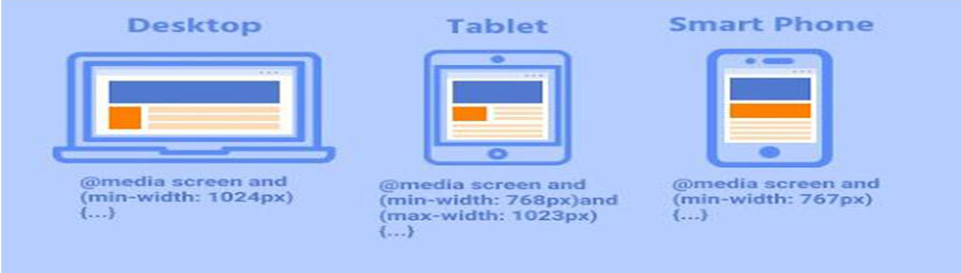
What are common breakpoints?
Common breakpoints are
320px — 480px for mobile devices,
481px — 768px for iPads & tablets,
769px — 1024px for small screens like laptop,
1025px — 1200px for large screens like Desktops, and
1201px and above for extra large screens like TV

Slide 29
Examples
/* smaller than 1024 pixels */
@media screen and (max-width: 1024px) {
style rules here
}
/* smaller than 768 pixels */
@media screen and (max-width: 768px) {
style rules here
}
/* smaller than 480 pixels */
@media screen and (max-width: 480px) {
style rules here
}
You can add multiple media features with the and keyword.
@media screen and (min-width: 480px) and (max-width: 768px)

Slide 30
Should You Use Pixels, Ems, Or Percentages In Breakpoints?
When defining things such as margins, padding, and font sizes, we mostly use pixels, but they are absolute units which means that they are not affected by any other factor in CSS.
With many devices rolling out, it’s impractical to cover all the new devices for applying CSS breakpoints
Rather, try to choose breakpoints based on the web design and target devices that are extensively used by the audience in the target markets.

Slide 31
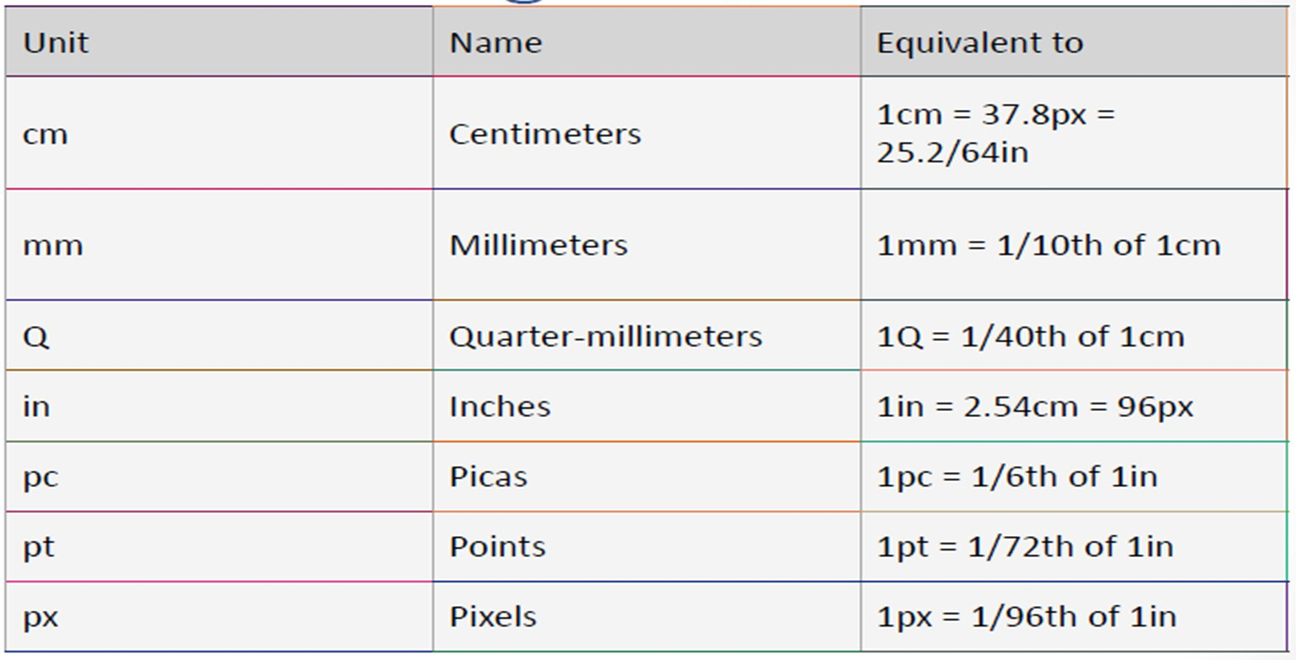
Absolute length units
Most of these units are more useful when used for print, rather than screen output. The only value that you will commonly use is px (pixels) instead of cm (centimeters) on screen.

Slide 32
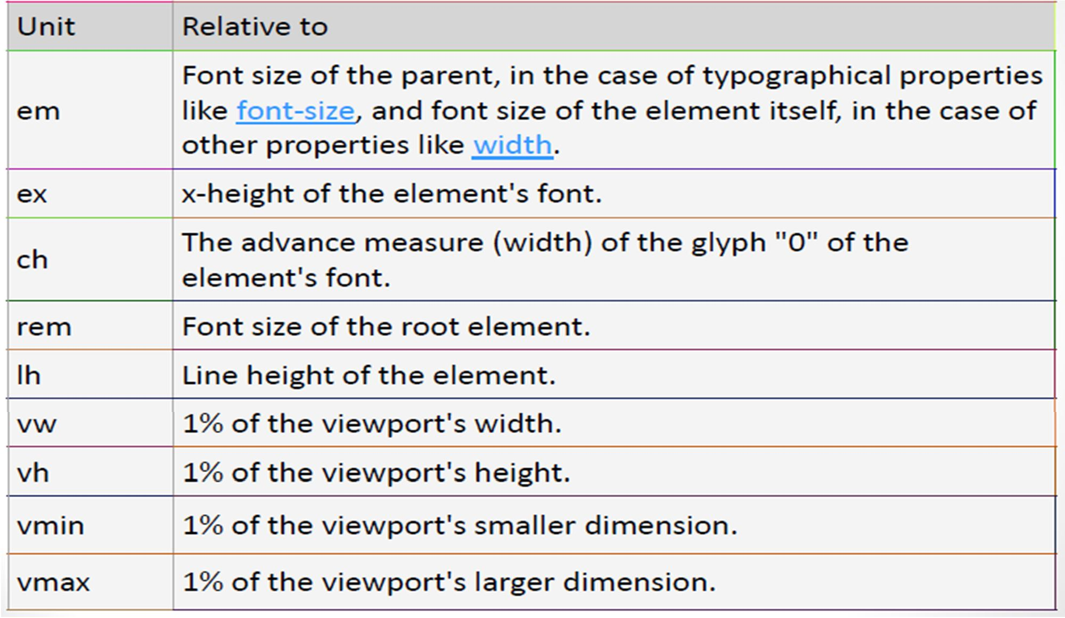
Relative length units

Slide 33
<!DOCTYPE html><html><head>
<meta name="viewport" content="width=device-width, initial- scale=1.0"> </head><body>
•<h2>ResponsiveText</h2>
•<p style="font-size:10vw;">Use the "vw" unit when sizing the text.
•10vw will set the size to 10% of the viewport width.</p>
•<p>Viewport is the browser window size. 1vw = 1% of viewport width.
•If the viewport is 50cm wide, 1vw is 0.5cm.</p>
•<h2>Responsive Image</h2>
•<p>When the CSS width property is set in a percentage value, the image will scale up and down when resizing the browser window. Resize the browser window to see the effect.</p>
•<img src="image.png" style="width:100%;"></body></html>

Slide 34
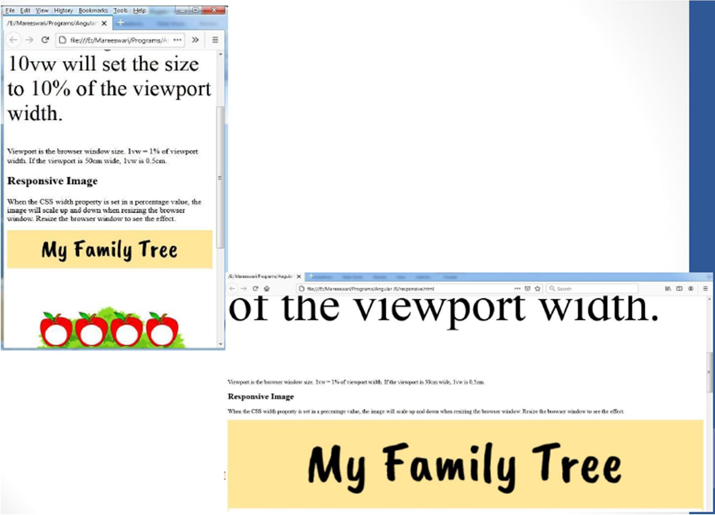

Slide 35
Responsive Web Design - Images
Using The width Property
If the width property is set to a percentage and the height property is set to "auto", the image will be responsive and scale up and down:
img { width: 100%; height: auto; }
Using The max-width Property
If the max-width property is set to 100%, the image will scale down if it has to, but never scale up to be larger than its original size:
Example
img {
max-width: 100%; height: auto;
}

